Slide 1
Machine Learning in NLP
Building Transformer-Based Natural Language Processing Applications (Part 1)

Slide 2
FULL COURSE AGENDA
Part 1: Machine Learning in NLP Lecture: NLP background and the role of DNNs leading to the Transformer architecture Lab: Tutorial-style exploration of a translation task using the Transformer architecture
Part 2: Self-Supervision, BERT, and Beyond Lecture: Discussion of how language models with self-supervision have moved beyond the basic Transformer to BERT and ever larger models Lab: Practical hands-on guide to the NVIDIA NeMo API and exercises to build a text classification task and a named entity recognition task using BERT-based language models
Part 3: Production Deployment Lecture: Discussion of production deployment considerations and NVIDIA Triton Inference Server Lab: Hands-on deployment of an example question answering task to NVIDIA Triton
Notes:
The course has three parts. This is part 1, “Machine Learning in NLP”.

Slide 3
Part 1: Machine Learning in NLP
Lecture
What is NLP?
Problem Formulation
Text Representations
Dimensionality Reduction
Embeddings
RNNs
“Attention is All You Need”
Lab
Transformer Architecture
BERT Model
Pretraining BERT
Notes:
In this part, there will both a lecture and a hands-on lab section. In the lecture we’ll cover these topics. The goal of this lecture is to provide a good overview of NLP tasks, and the technologies to date (briefly) that have led us to the Transformer architecture, which was presented in the now-famous Google paper, “Attention is All You Need”.

Slide 4
Foundation of countless applications

Slide 5
Automatic Writing
NLP TASKS
General Q&A
Intent Detection
Summary Generation
Common Sense Reasoning
Natural Language Processing
Word Sense
Auto Completion
Automatic Dialogue Generation
Translation
Sentiment Analysis
Code Generation
And many more….

Slide 6
GLIMPSE OF WHAT IS POSSIBLE, TODAY…

Slide 7
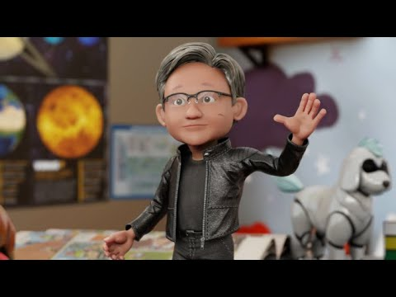

Slide 8

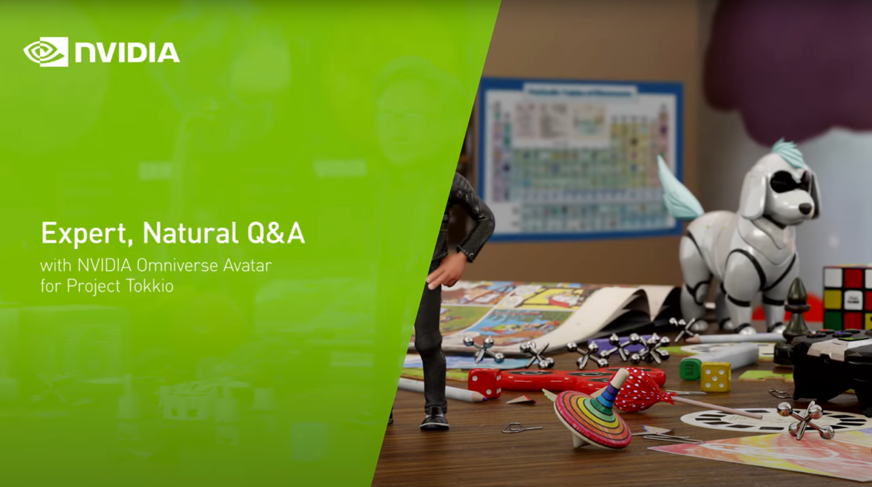
Large NLP models powers:
Multi-turn Information Retrieval for Q&A

Slide 9
Part 1: Machine Learning in NLP
Lecture
What is NLP?
Problem Formulation
Text Representations
Dimensionality Reduction
Embeddings
RNNs
“Attention is All You Need”
Lab
Transformer Architecture
BERT Model
Pretraining BERT
Notes:
In this part, there will both a lecture and a hands-on lab section. In the lecture we’ll cover these topics. The goal of this lecture is to provide a good overview of NLP tasks, and the technologies to date (briefly) that have led us to the Transformer architecture, which was presented in the now-famous Google paper, “Attention is All You Need”.

Slide 10
Problem Formulation
Notes:
To put it in perspective

Slide 11
Machine Learning
Discovering the discussed structures in text
Machine Learning Algorithm
Text

Slide 12
Machine Learning
Discovering the discussed structures in text
?
Machine Learning Algorithm
Text

Slide 13
Machine Learning
Design decisions
?
Problem formulation
?
?
?
?
?
?
Machine Learning Algorithm
Text Pre-processing
Text Representation
Reweighting
Dimensionality Reduction
Vector Comparison
Text

Slide 14
Machine Learning
All linear combinations feasible
?
Problem formulation
?
?
?
?
?
?
Machine Learning Algorithm
Text Pre-processing
Text Representation
Reweighting
Dimensionality Reduction
Vector Comparison
Text
GloVe
Word2Vec

Slide 15
Machine Learning
In this class
Subset of Problem formulations
Machine Learning Algorithm
Text Pre-processing
Text Representation
Reweighting
Dimensionality Reduction
Vector Comparison
Text
Subset of
approaches
Subset of word representations

Slide 16
Part 1: Machine Learning in NLP
Lecture
What is NLP?
Problem Formulation
Text Representations
Dimensionality Reduction
Embeddings
RNNs
“Attention is All You Need”
Lab
Transformer Architecture
BERT Model
Pretraining BERT
Notes:
In this part, there will both a lecture and a hands-on lab section. In the lecture we’ll cover these topics. The goal of this lecture is to provide a good overview of NLP tasks, and the technologies to date (briefly) that have led us to the Transformer architecture, which was presented in the now-famous Google paper, “Attention is All You Need”.

Slide 17
Text Representations
The bag of words
Bag of words/ngrams – feature per word/ngram
the cat sat on the mat
Various ways of choosing the values: Binary, Count, TF-IDF
cat | sat | on | the | mat | quickly
1 | 1 | 1 | 2 | 1 | 0
… |Vocabulary|

Slide 18
The Bag of words
Key challenges
Sparse Input (1-hot)
No semantic generalization
dog: 1 0 0 0 0 … 0
cat: 0 0 1 0 0 … 0
p >> n (overfitting!)
…
…
…
Word 1
Word n
Word 1
Word n
lots of data required,
low accuracy
Notes:
There are several issues with the BoW representation:
Sparse Input – As we saw in the previous example, each word is a feature. Hence, when providing this data to a model, we need to let it know that we mean feature number 1 in the BoW table which is cat, and not feature number 2 which is dog. We do this by performing a 1-hot encoding on the numbers: we create a vector with the size of the entire vocabulary. We then give the index we want the value 1 while all others are given the value 0. So cat will be the vector (1,0,0,…,|V|), dog will be (0,1,0,0,…,|V|), etc. For a large vocabulary (i.e., |V| is large) this means that much of the input data will be sparse – that is, have the value 0. The impact of sparseness is that the number of features (words) will potentially be much larger than the number of examples we have which will almost certainly lead to overfitting.
No semantic generalization – In this example, dog is feature #1 while cat is #2. Note that this is completely arbitrary. In particular, this means that we cannot generalize. In other words, the model is unable to apply knowledge that it learned about cats to dogs as it is completely unaware that the two are related (both are animals, have 4 legs and a tail, etc.). Ideally we would have liked a model that deals with animals to understand the similarities as well as the differences between animals before it dealt with our specific task. Putting it somewhat figuratively, we would have liked the model to show some innate intelligence.

Slide 19
Distributed Word Representations
Notes:
To put it in perspective

Slide 20
Distributional Hypothesis
The intuition
‘You can tell a word by the company it keeps’
Firth 1957
‘Distributional statements can cover all of the material of a language without requiring support from other types of information’
Harris 1954
‘The meaning of a word is its use in the language’
Wittgenstein 1953
‘The complete meaning of a word is always contextual, and no study of meaning apart from context can be taken seriously.’
Firth 1957

Slide 21
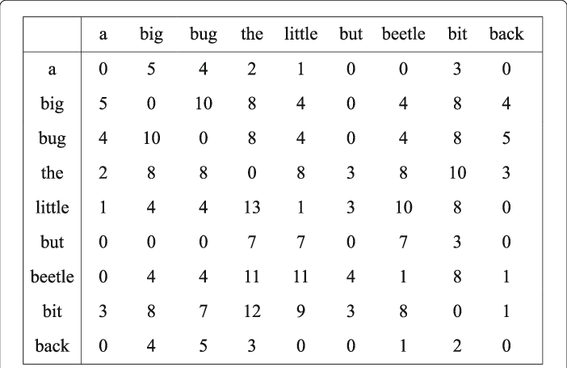
Co-occurrence patterns
The latent information

Slide 22
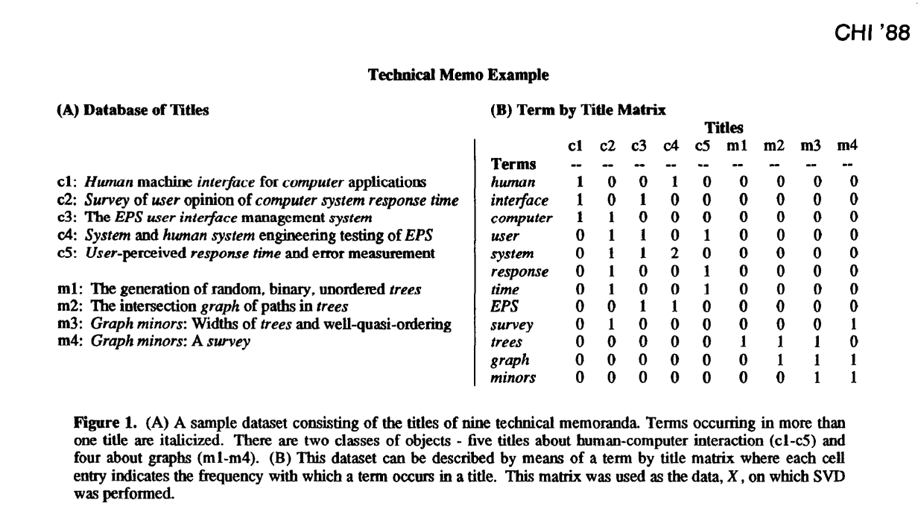
Co-occurrence patterns
Where to find them?
Possible relationships:
Word to documents (very sparse and very wide)
Word to word (very dense and compact)
Word to user / person
Word to user behaviour
Word to product
Word to custom feature (e.g. movie raking)
Not only metrices:
Word to user to product

Slide 23
Part 1: Machine Learning in NLP
Lecture
What is NLP?
Problem Formulation
Text Representations
Dimensionality Reduction
Embeddings
RNNs
“Attention is All You Need”
Lab
Transformer Architecture
BERT Model
Pretraining BERT
Notes:
In this part, there will both a lecture and a hands-on lab section. In the lecture we’ll cover these topics. The goal of this lecture is to provide a good overview of NLP tasks, and the technologies to date (briefly) that have led us to the Transformer architecture, which was presented in the now-famous Google paper, “Attention is All You Need”.

Slide 24
Dimensionality Reduction
Rationale
The need for compact and computationally efficient representations
More robust notions of distance exposing the information captured by our distributional representation

Slide 25
LSA/LSI
Notes:
To put it in perspective

Slide 26
LSA/LSI
Latent Semantic Analysis / Latent Semantic Indexing
?

Slide 27
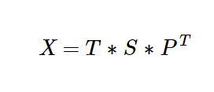
LLSA/LSI
Truncated SVD
Terms x Documents
Dumais, Susan T., et al. "Using latent semantic analysis to improve access to textual information." Proceedings of the SIGCHI conference on Human factors in computing systems. 1988.

Slide 28
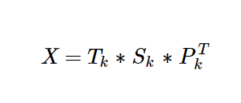
LSA/LSI
Truncated SVD
Terms x Documents
K largest singular values
Dumais, Susan T., et al. "Using latent semantic analysis to improve access to textual information." Proceedings of the SIGCHI conference on Human factors in computing systems. 1988.

Slide 29
LSA/LSI
Truncated SVD
Terms x Documents
K largest singular values
Latent Semantic Space
Dumais, Susan T., et al. "Using latent semantic analysis to improve access to textual information." Proceedings of the SIGCHI conference on Human factors in computing systems. 1988.

Slide 30
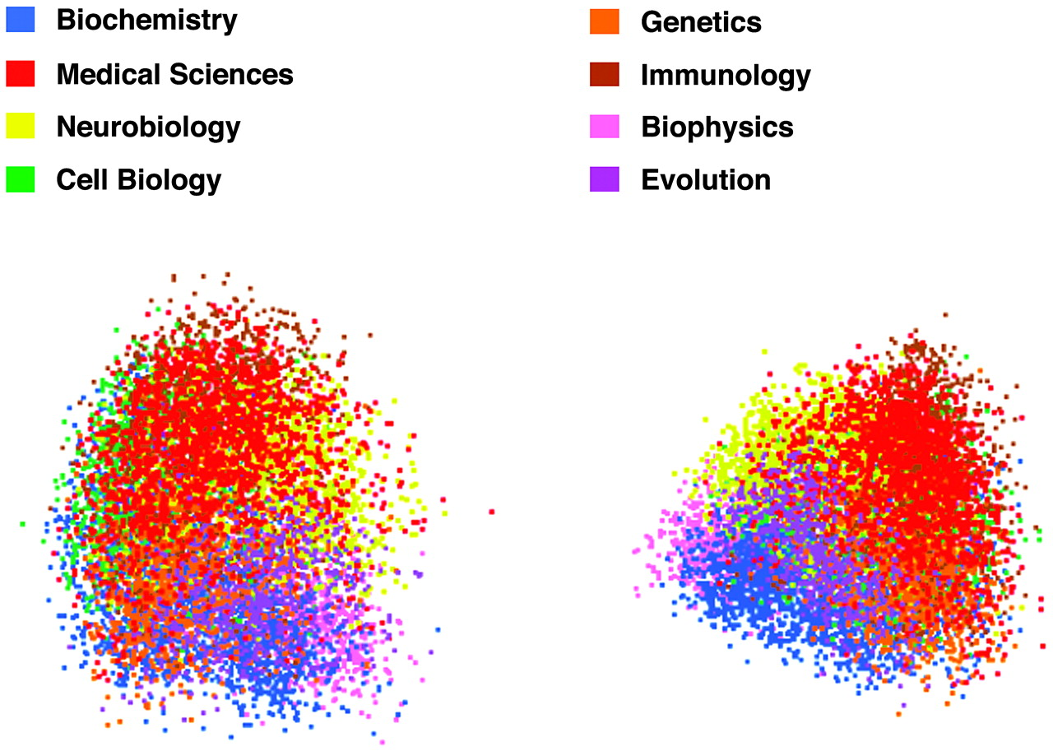
LSA/LSI
Documents that are similar are closer
Landauer, Thomas K., Darrell Laham, and Marcia Derr. "From paragraph to graph: Latent semantic analysis for information visualization." Proceedings of the National Academy of Sciences 101.suppl 1 (2004): 5214-5219.

Slide 31
LSA/LSI
Its so 1988
Dumais, Susan T., et al. "Using latent semantic analysis to improve access to textual information." Proceedings of the SIGCHI conference on Human factors in computing systems. 1988.

Slide 32
Did we make further progress?
Notes:
To put it in perspective

Slide 33
Status as of 2010
Yes and No
Clustering Based Representations
Brown Clustering
HMM-LDA
CRF Chunker with HMM
…
It was not clear that you can combine unsupervised approaches
(i.e. embeddings) with supervised models
Distributed Representations
Collobert and Weston embeddings
HLBL embeddings
…
Distributional Representations
LSA / LSI
pLSA
LDA
HAL
ICA
Random Indexing
…
Machine Learning Algorithm
Unsupervised embedding
Text
Turian, Joseph, Lev Ratinov, and Yoshua Bengio. "Word representations: a simple and general method for semi-supervised learning." Proceedings of the 48th annual meeting of the association for computational linguistics. 2010.

Slide 34
Part 1: Machine Learning in NLP
Lecture
What is NLP?
Problem Formulation
Text Representations
Dimensionality Reduction
Embeddings
RNNs
“Attention is All You Need”
Lab
Transformer Architecture
BERT Model
Pretraining BERT
Notes:
In this part, there will both a lecture and a hands-on lab section. In the lecture we’ll cover these topics. The goal of this lecture is to provide a good overview of NLP tasks, and the technologies to date (briefly) that have led us to the Transformer architecture, which was presented in the now-famous Google paper, “Attention is All You Need”.

Slide 35
Why not do the same with Neural Networks?
Notes:
To put it in perspective

Slide 36
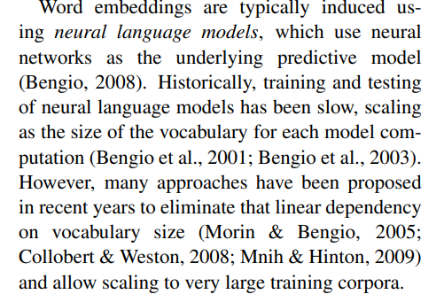
Status as of 2010
Not enough computational power
Turian, Joseph, Lev Ratinov, and Yoshua Bengio. "Word representations: a simple and general method for semi-supervised learning." Proceedings of the 48th annual meeting of the association for computational linguistics. 2010.

Slide 37
Word2Vec
Notes:
To put it in perspective

Slide 38
Word2Vec
Mikolov et al., 2013 (while at Google)
Linear model (trains quickly)
Two models for training embeddings in an unsupervised manner:
Continuous Bag-of-Words (CBOW)
Skip-Gram
cat
PAD
the
sat
on
1-hot (|V|)
1-hot (|V|)
d-dimensional
Σ
d-dimensional
d-dimensional
E
E
E
E
E
E
E
E
d-dimensional
1-hot (|V|)
1-hot (|V|)
cat
cat
cat
cat
PAD
the
sat
on
Notes:
The main question now is how to implement an algorithm that generates word embeddings. There are multiple such algorithms. In this lab, you will work primarily with the Word2Vec algorithm that was invented by Mikolov et al. while at Google.
Word2Vec has two variants:
Continuous Bag-of-Words (CBOW): In this variant, using a number of context words, we try to predict the target word. Notice that by summing the embedding vectors we lose the word order, hence the BoW name.
Skip-Gram: In this variant we use the target word to predict each of the context words.
Note the words marked PAD – these are padding markers, signifying that there are no actual words here. Essentially, these are NULL markers for denoting empty context words.
A key property of the Word2Vec algorithm is that it is unsupervised (or more precisely, self-supervised). This means that it can be trained with huge corpora and generate very useful embedding vectors.

Slide 39
Glove
Notes:
To put it in perspective

Slide 40
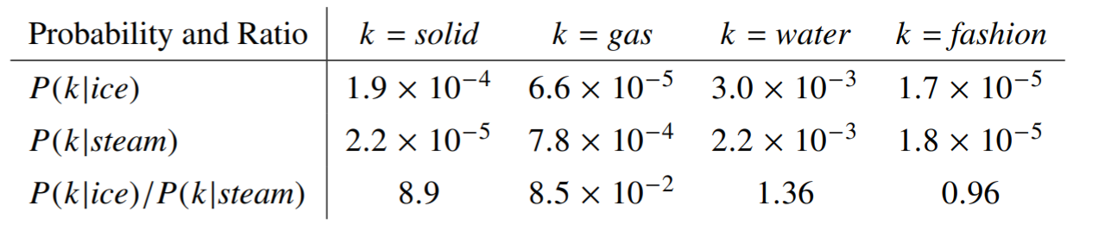
Glove
The objective
To learn vectors for words such that their dot product is proportional to their probability of co-occurence
Pennington, J., Socher, R., & Manning, C. D. (2014, October). Glove: Global vectors for word representation. In Proceedings of the 2014 conference on empirical methods in natural language processing (EMNLP) (pp. 1532-1543).
Notes:
The main question now is how to implement an algorithm that generates word embeddings. There are multiple such algorithms. In this lab, you will work primarily with the Word2Vec algorithm that was invented by Mikolov et al. while at Google.
Word2Vec has two variants:
Continuous Bag-of-Words (CBOW): In this variant, using a number of context words, we try to predict the target word. Notice that by summing the embedding vectors we lose the word order, hence the BoW name.
Skip-Gram: In this variant we use the target word to predict each of the context words.
Note the words marked PAD – these are padding markers, signifying that there are no actual words here. Essentially, these are NULL markers for denoting empty context words.
A key property of the Word2Vec algorithm is that it is unsupervised (or more precisely, self-supervised). This means that it can be trained with huge corpora and generate very useful embedding vectors.

Slide 41
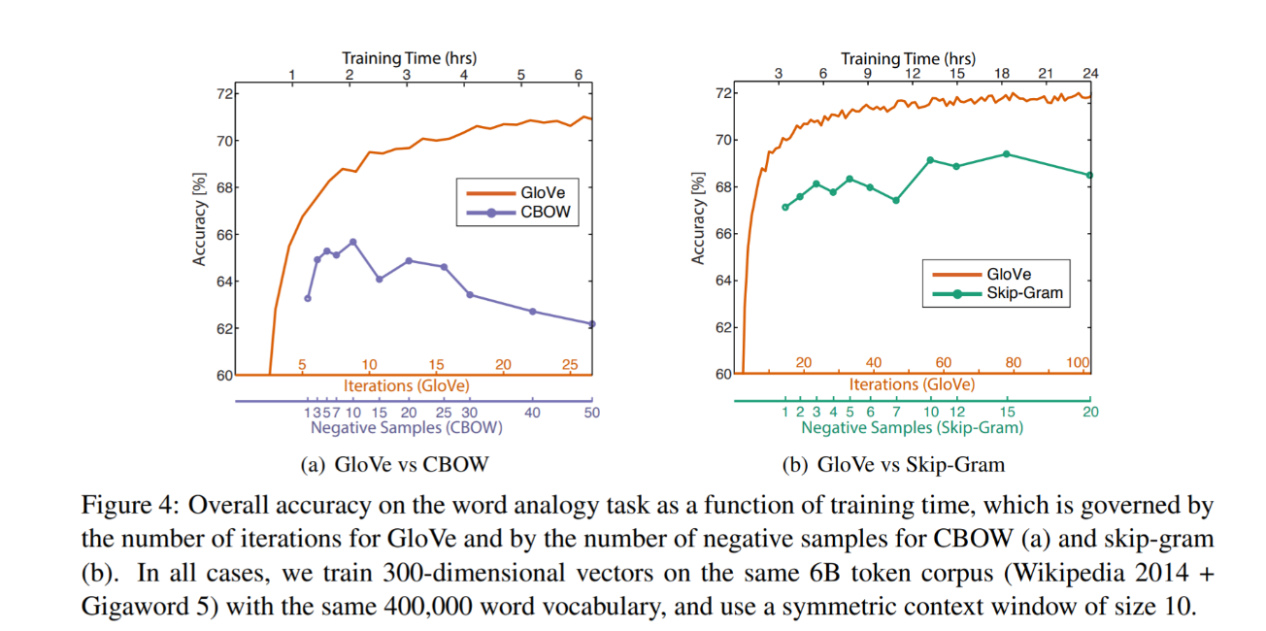
Glove
The objective
Pennington, J., Socher, R., & Manning, C. D. (2014, October). Glove: Global vectors for word representation. In Proceedings of the 2014 conference on empirical methods in natural language processing (EMNLP) (pp. 1532-1543).
Notes:
The main question now is how to implement an algorithm that generates word embeddings. There are multiple such algorithms. In this lab, you will work primarily with the Word2Vec algorithm that was invented by Mikolov et al. while at Google.
Word2Vec has two variants:
Continuous Bag-of-Words (CBOW): In this variant, using a number of context words, we try to predict the target word. Notice that by summing the embedding vectors we lose the word order, hence the BoW name.
Skip-Gram: In this variant we use the target word to predict each of the context words.
Note the words marked PAD – these are padding markers, signifying that there are no actual words here. Essentially, these are NULL markers for denoting empty context words.
A key property of the Word2Vec algorithm is that it is unsupervised (or more precisely, self-supervised). This means that it can be trained with huge corpora and generate very useful embedding vectors.

Slide 42
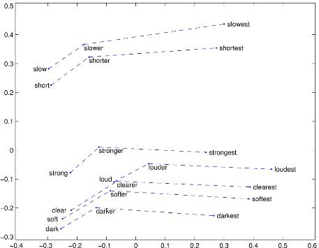
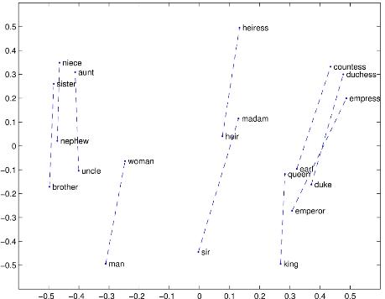
Glove
Properties
Comparative - Superlative
Man - Woman
Pennington, J., Socher, R., & Manning, C. D. (2014, October). Glove: Global vectors for word representation. In Proceedings of the 2014 conference on empirical methods in natural language processing (EMNLP) (pp. 1532-1543).

Slide 43
Glove
Not a distant past
Pennington, J., Socher, R., & Manning, C. D. (2014, October). Glove: Global vectors for word representation. In Proceedings of the 2014 conference on empirical methods in natural language processing (EMNLP) (pp. 1532-1543).

Slide 44
Using the embeddings
Notes:
To put it in perspective

Slide 45
THE Approach to NLP
Unsupervised feature representation + Machine Learning models
Subset of Problem formulations
Machine Learning Algorithm
Text Pre-processing
Text Representation
Reweighting
Dimensionality Reduction
Vector Comparison
Text
Subset of
approaches
Subset of word representations

Slide 46
THE Approach to NLP
What ML model to choose
Subset of Problem formulations
?
Machine Learning Algorithm
Text Pre-processing
Text Representation
Reweighting
Dimensionality Reduction
Vector Comparison
Text
Subset of
approaches
Subset of word representations

Slide 47
Classical approaches
Notes:
To put it in perspective

Slide 48

Classical Approaches
Very broad selection of tools

Slide 49
What about Feature Engineering?
Notes:
Are classical models able to solve complex problems without additional feature engineering? Distributional approaches only capture information about co-occurance

Slide 50
Deep Representation Learning

Slide 51
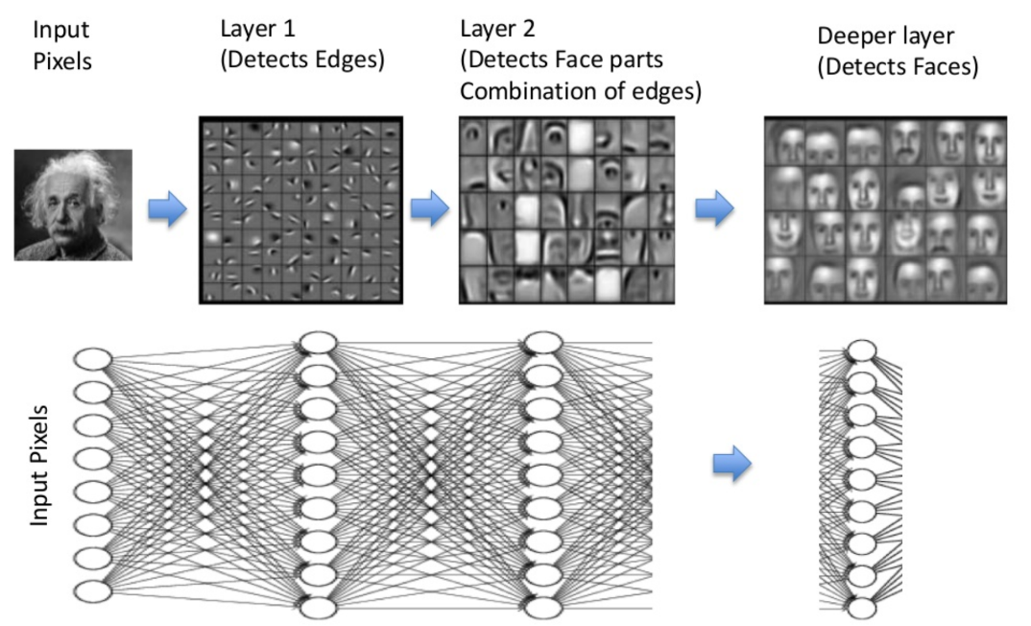
Deep Representation Learning
Beyond distributional hypothesis

Slide 52
Part 1: Machine Learning in NLP
Lecture
What is NLP?
Problem Formulation
Text Representations
Dimensionality Reduction
Embeddings
RNNs
“Attention is All You Need”
Lab
Transformer Architecture
BERT Model
Pretraining BERT
Notes:
In this part, there will both a lecture and a hands-on lab section. In the lecture we’ll cover these topics. The goal of this lecture is to provide a good overview of NLP tasks, and the technologies to date (briefly) that have led us to the Transformer architecture, which was presented in the now-famous Google paper, “Attention is All You Need”.

Slide 53
Recurrent Neural Networks
Basic principles
y
y_{t-1}
y_{t}
y_{t+1}
y_{t+2}
s
s_{t-1}
s_{t}
s_{t+1}
s_{t+2}
x
x_{t-1}
x_{t}
x_{t+1}
x_{t+2}
Unrolling in Time
Notes:
In the previous lab, we encountered Fully-Connected (FC) neural networks. We would either go forward (from layer i to i+1) when propagating information or backwards (from layer i+1 to i) when propagating the error. At no point did we go in a horizontal direction inside the same layer.
Often we wish to use neural networks with sequence inputs or outputs: in other words, our input/output consists of different values at different timesteps. For that, we need to use recurrent neural networks (RNNs). As shown in the example here, at each timestep we have different inputs (the X’s) and different outputs (the y’s). Additionally, we have the state from the previous timestep (the S’s) as input (with the initial state typically being the 0 vector).
The algorithm used to train RNN’s is just the usual backpropagation, applied to subsequent timesteps and hence known as Backpropagation-Through-Time (BPTT).

Slide 54
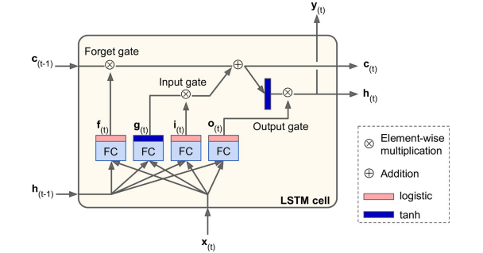
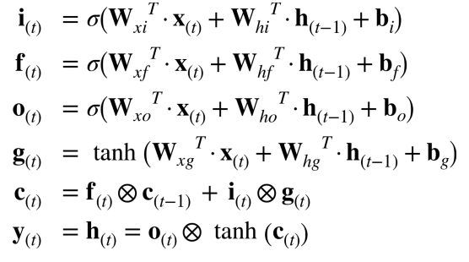
Long Short Term (LSTM) Cell
Addressing problems of stability
Notes:
Regular RNN’s are notoriously difficult to train. Because of the multiple timesteps, error gradients often tend to either shrink (‘vanish’) or grow (‘explode’) exponentially. This means that vanilla RNNs have difficulty with long sequences such as the ones we need for dealing with long text sequences.
A modification to the standard RNN is the Long Short-Term Memory (LSTM) cell, which overcomes many of the issues just mentioned. Essentially, it is a set of multiple neurons known as gates along with a memory cell. At each timestep, the cell receives input (x) along with the cell contents (c) and hidden state (h) from the previous timestep. The gates have the following functions:
Forget gate – what parts of the memory cell should be ‘forgotten’
Input gate – what parts of the input should be applied to the memory cell
Output gate - what parts of the memory cell should be exposed in the output of the cell
The new hidden state and memory cell state are then propagated to the next time step. The parameters are learned as usual using BPTT.

Slide 55
CNNs
Notes:
To put it in perspective

Slide 56
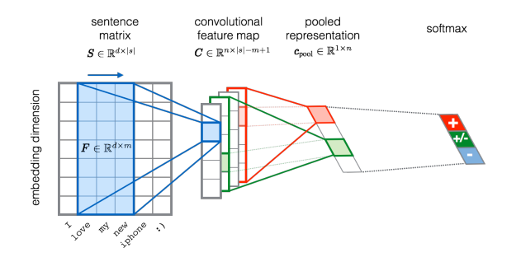
Convolutional Neural Networks
Basic principles
Severyn, Aliaksei, and Alessandro Moschitti. "Unitn: Training deep convolutional neural network for twitter sentiment classification." Proceedings of the 9th international workshop on semantic evaluation (SemEval 2015). 2015.

Slide 57
Attention
Notes:
To put it in perspective

Slide 58
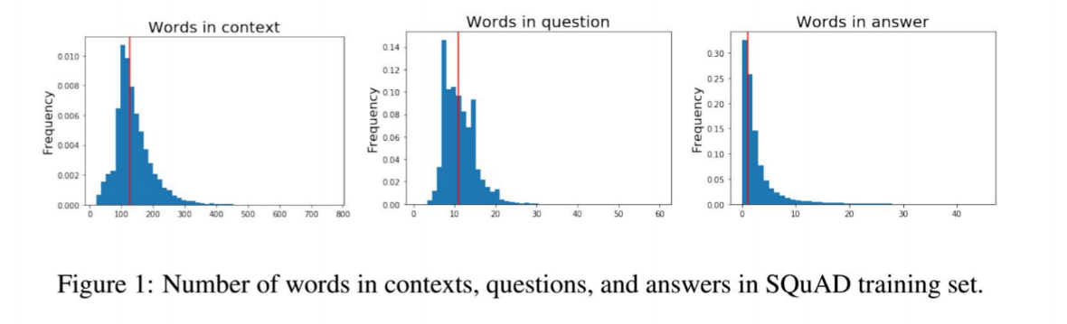
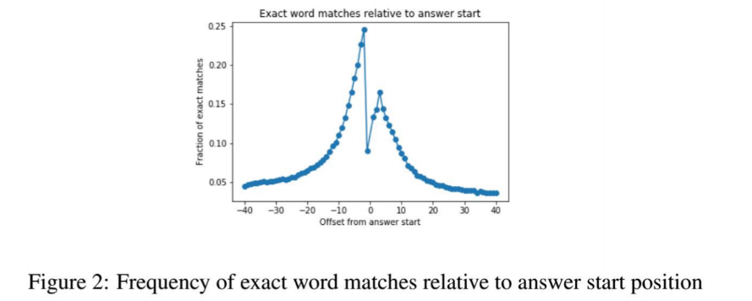
What about Long sequences?
The challenge illustrated with SQuAD
The impact of attention mechanism on Question Answering performance

Slide 59
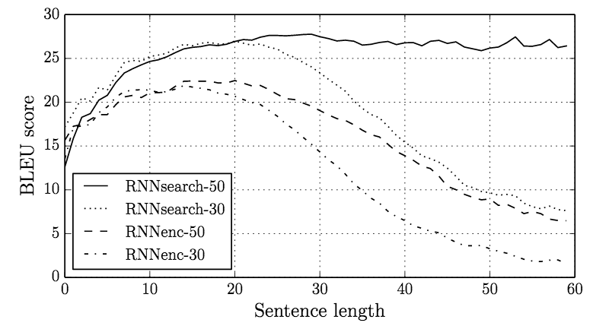
What about Long sequences?
The challenge
Bahdanau, D., Cho, K., & Bengio, Y. (2014). Neural machine translation by jointly learning to align and translate. arXiv preprint arXiv:1409.0473.

Slide 60
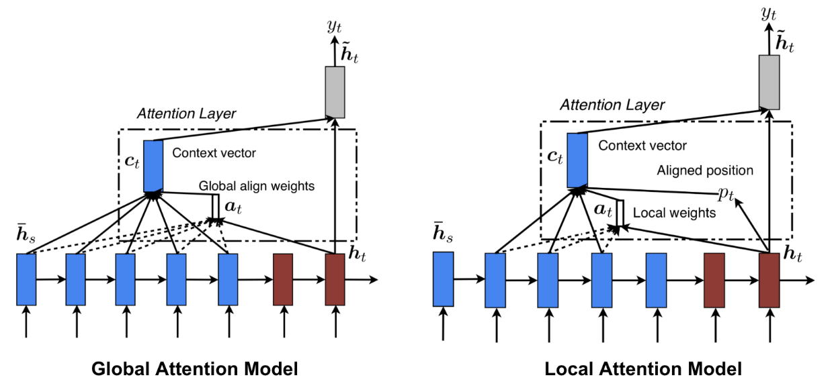
attention
The mechanism
Bahdanau, D., Cho, K., & Bengio, Y. (2014). Neural machine translation by jointly learning to align and translate. arXiv preprint arXiv:1409.0473.

Slide 61
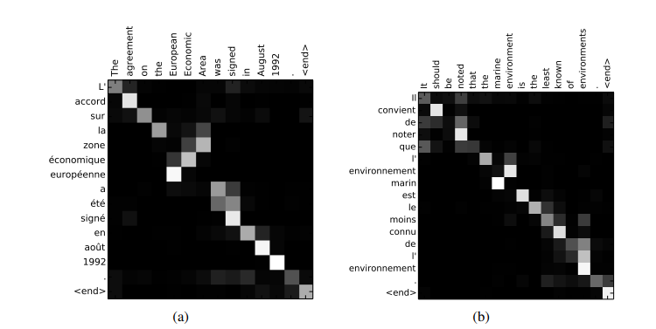
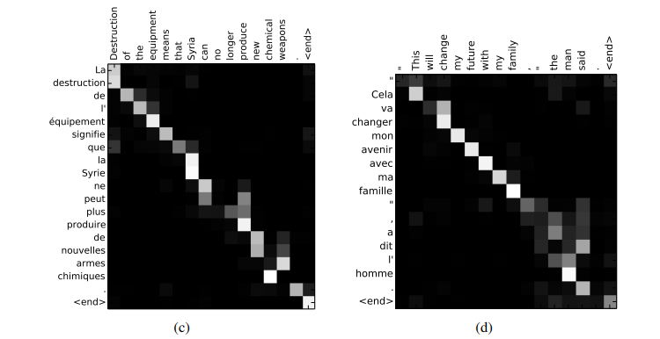
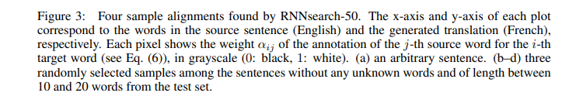
attention
The mechanism
Bahdanau, D., Cho, K., & Bengio, Y. (2014). Neural machine translation by jointly learning to align and translate. arXiv preprint arXiv:1409.0473.

Slide 62
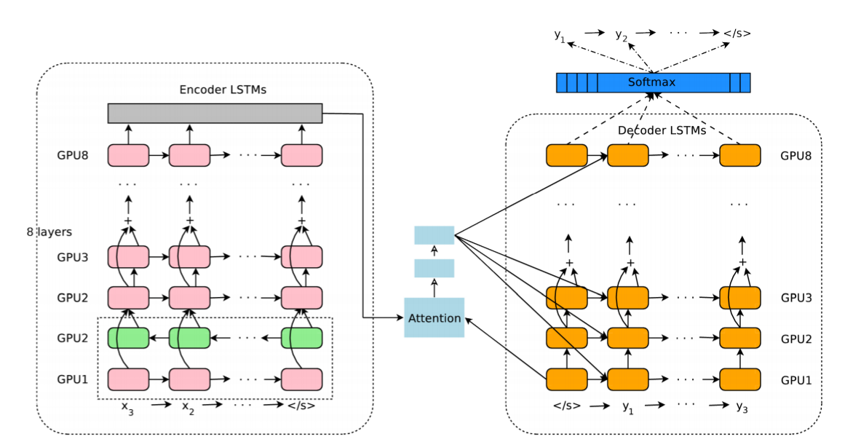
attention
Examples
Wu, Y., Schuster, M., Chen, Z., Le, Q. V., Norouzi, M., Macherey, W., ... & Klingner, J. (2016). Google's neural machine translation system: Bridging the gap between human and machine translation. arXiv preprint arXiv:1609.08144.

Slide 63
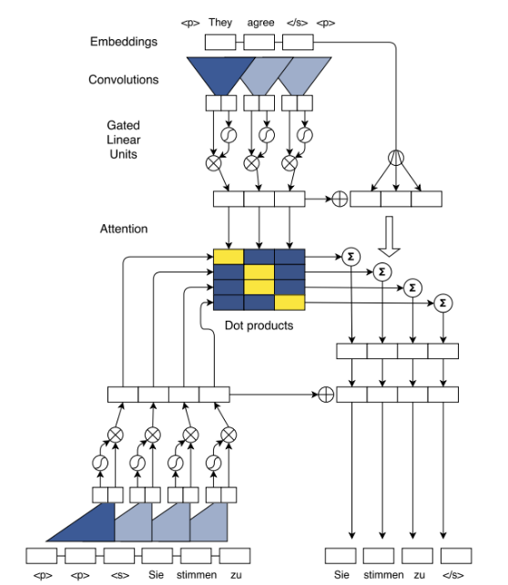
attention
Examples
Ott, M., Edunov, S., Baevski, A., Fan, A., Gross, S., Ng, N., ... & Auli, M. (2019). fairseq: A fast, extensible toolkit for sequence modeling. arXiv preprint arXiv:1904.01038.

Slide 64
Part 1: Machine Learning in NLP
Lecture
What is NLP?
Problem Formulation
Text Representations
Dimensionality Reduction
Embeddings
RNNs
“Attention is All You Need”
Lab
Transformer Architecture
BERT Model
Pretraining BERT
Notes:
In this part, there will both a lecture and a hands-on lab section. In the lecture we’ll cover these topics. The goal of this lecture is to provide a good overview of NLP tasks, and the technologies to date (briefly) that have led us to the Transformer architecture, which was presented in the now-famous Google paper, “Attention is All You Need”.

Slide 65
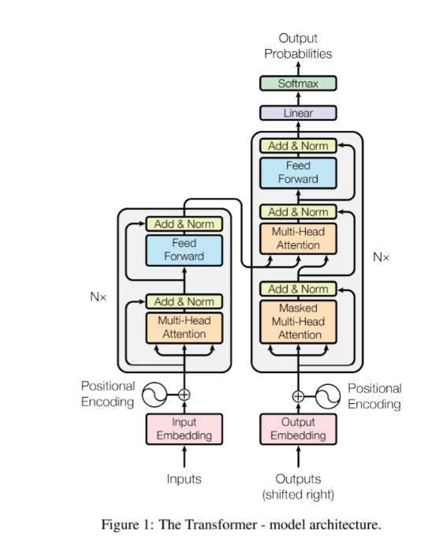
Attention is all you need
Design
Vaswani, A., Shazeer, N., Parmar, N., Uszkoreit, J., Jones, L., Gomez, A. N., ... & Polosukhin, I. (2017). Attention is all you need. In Advances in neural information processing systems (pp. 5998-6008).

Slide 66
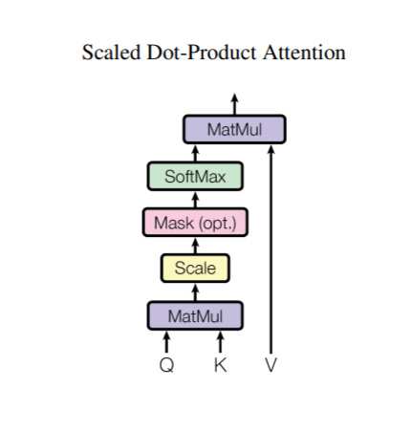
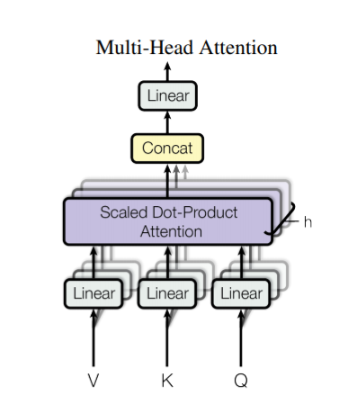
Attention is all you need
Design
Vaswani, A., Shazeer, N., Parmar, N., Uszkoreit, J., Jones, L., Gomez, A. N., ... & Polosukhin, I. (2017). Attention is all you need. In Advances in neural information processing systems (pp. 5998-6008).

Slide 67
Was it a breakthrough in itself?
Notes:
To put it in perspective

Slide 68
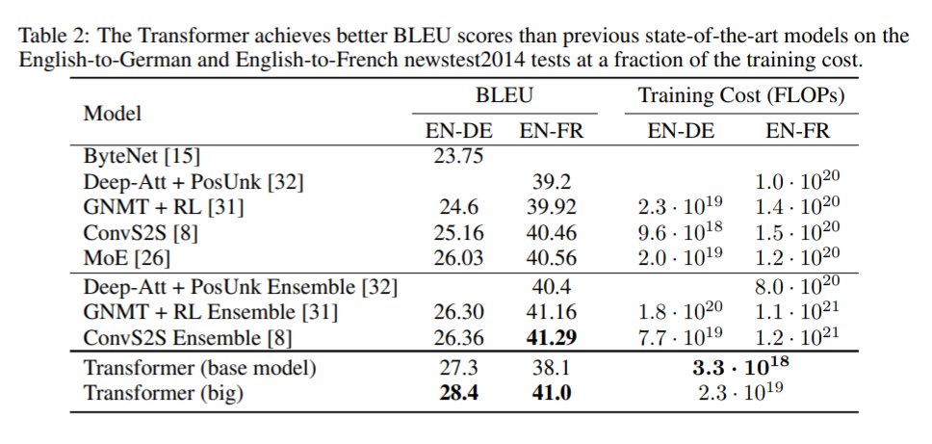
Attention is all you need
Not a breakthrough in itself
Vaswani, A., Shazeer, N., Parmar, N., Uszkoreit, J., Jones, L., Gomez, A. N., ... & Polosukhin, I. (2017). Attention is all you need. In Advances in neural information processing systems (pp. 5998-6008).

Slide 69
Attention is all you need
But …
“ … the Transformer can be trained significantly faster than architectures based on recurrent or convolutional layers.”
Vaswani, A., Shazeer, N., Parmar, N., Uszkoreit, J., Jones, L., Gomez, A. N., ... & Polosukhin, I. (2017). Attention is all you need. In Advances in neural information processing systems (pp. 5998-6008).

Slide 70
Neural Embeddings
Notes:
To put it in perspective

Slide 71
feature reuse
The opportunity

Slide 72
It was difficult to reuse NLP embeddings
Notes:
To put it in perspective

Slide 73
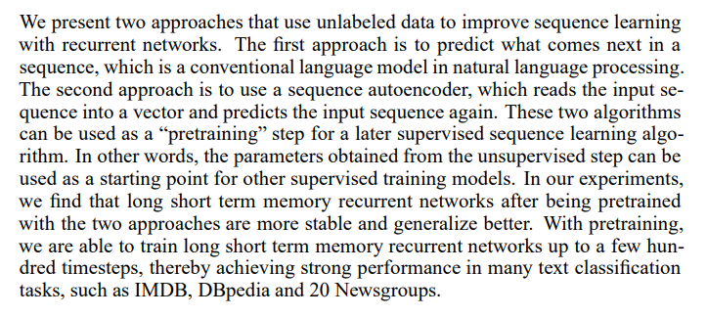
Semi-Supervised Sequence Learning
More complex representations
Dai, A. M., & Le, Q. V. (2015). Semi-supervised sequence learning. In Advances in neural information processing systems (pp. 3079-3087).

Slide 74
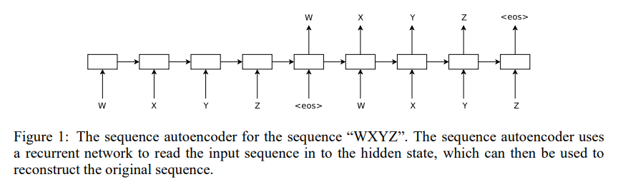
Semi-Supervised Sequence Learning
More complex representations
Dai, A. M., & Le, Q. V. (2015). Semi-supervised sequence learning. In Advances in neural information processing systems (pp. 3079-3087).

Slide 75
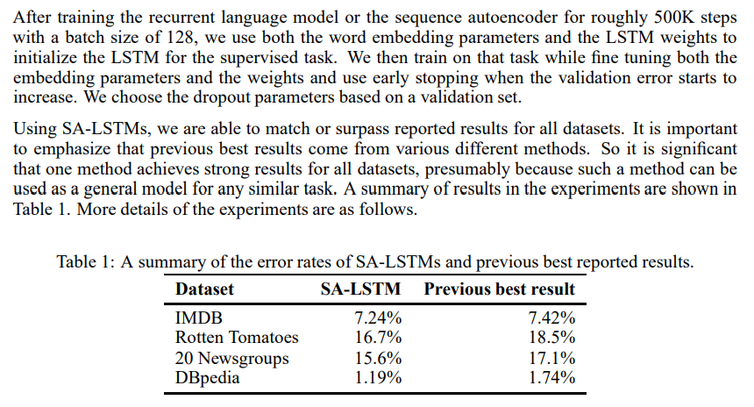
Semi-Supervised Sequence Learning
More complex representations
Dai, A. M., & Le, Q. V. (2015). Semi-supervised sequence learning. In Advances in neural information processing systems (pp. 3079-3087).

Slide 76
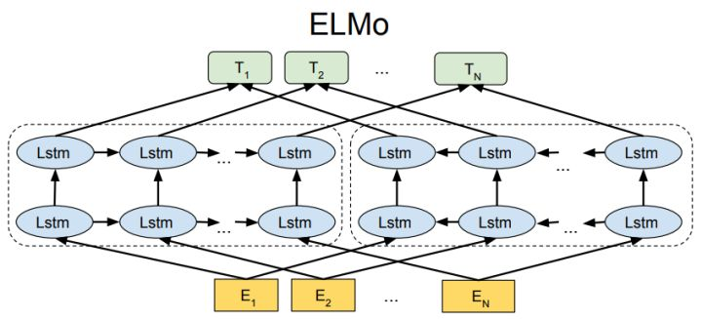
ELMo
Embeddings for Language Models
Peters, M. E., Neumann, M., Iyyer, M., Gardner, M., Clark, C., Lee, K., & Zettlemoyer, L. (2018). Deep contextualized word representations. arXiv preprint arXiv:1802.05365.

Slide 77
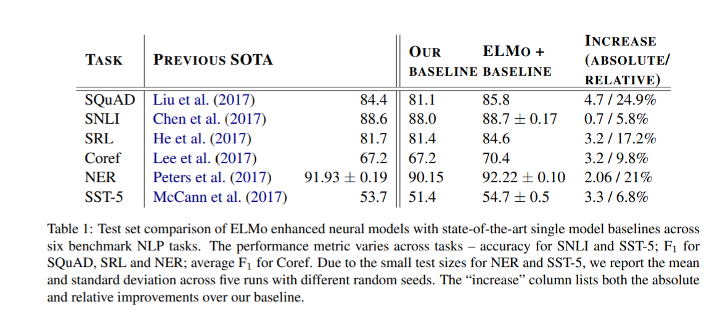
ELMo
Embeddings for Language Models
Peters, M. E., Neumann, M., Iyyer, M., Gardner, M., Clark, C., Lee, K., & Zettlemoyer, L. (2018). Deep contextualized word representations. arXiv preprint arXiv:1802.05365.

Slide 78
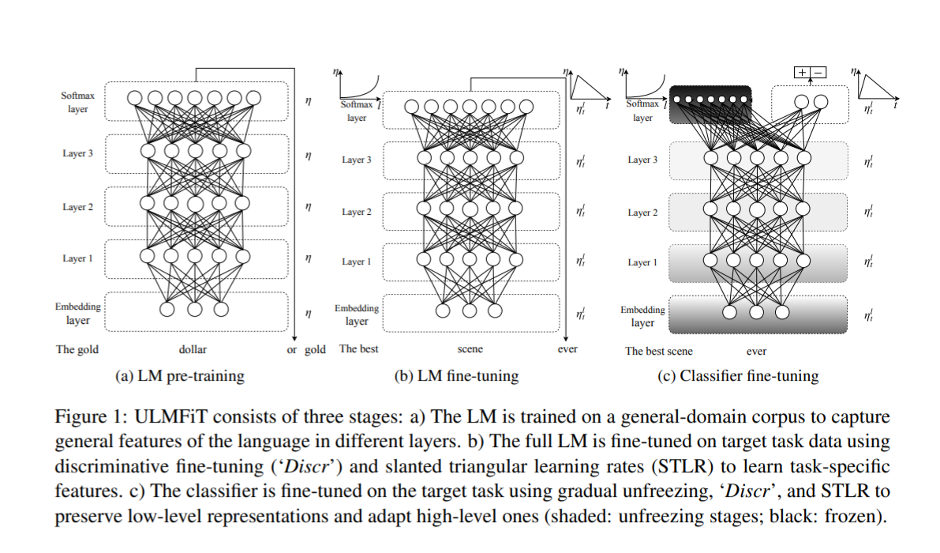
ULM-Fit
Universal Language Model Fine-Tuning for Text Classification
Howard, J., & Ruder, S. (2018). Universal language model fine-tuning for text classification. arXiv preprint arXiv:1801.06146.

Slide 79
Transfer Learning in NLP
Not trivial to use and not universally applicable
Howard, J., & Ruder, S. (2018). Universal language model fine-tuning for text classification. arXiv preprint arXiv:1801.06146.
Peters, M. E., Neumann, M., Iyyer, M., Gardner, M., Clark, C., Lee, K., & Zettlemoyer, L. (2018). Deep contextualized word representations. arXiv preprint arXiv:1802.05365.
1957
1988
2010
2013/
2014
2018
Distributional
Hypothesis
LSA / LSI
The use of unsupervised
embeddings
Success of NN
First successes in
transfer learning

Slide 80
This Created a foundation for the new NLP Models (discussed in the next class)
Notes:
To put it in perspective

Slide 81
The Lab
Notes:
To put it in perspective

Slide 82
Attention is all you need
Deep dive into the transformer design
Vaswani, A., Shazeer, N., Parmar, N., Uszkoreit, J., Jones, L., Gomez, A. N., ... & Polosukhin, I. (2017). Attention is all you need. In Advances in neural information processing systems (pp. 5998-6008).

Slide 83
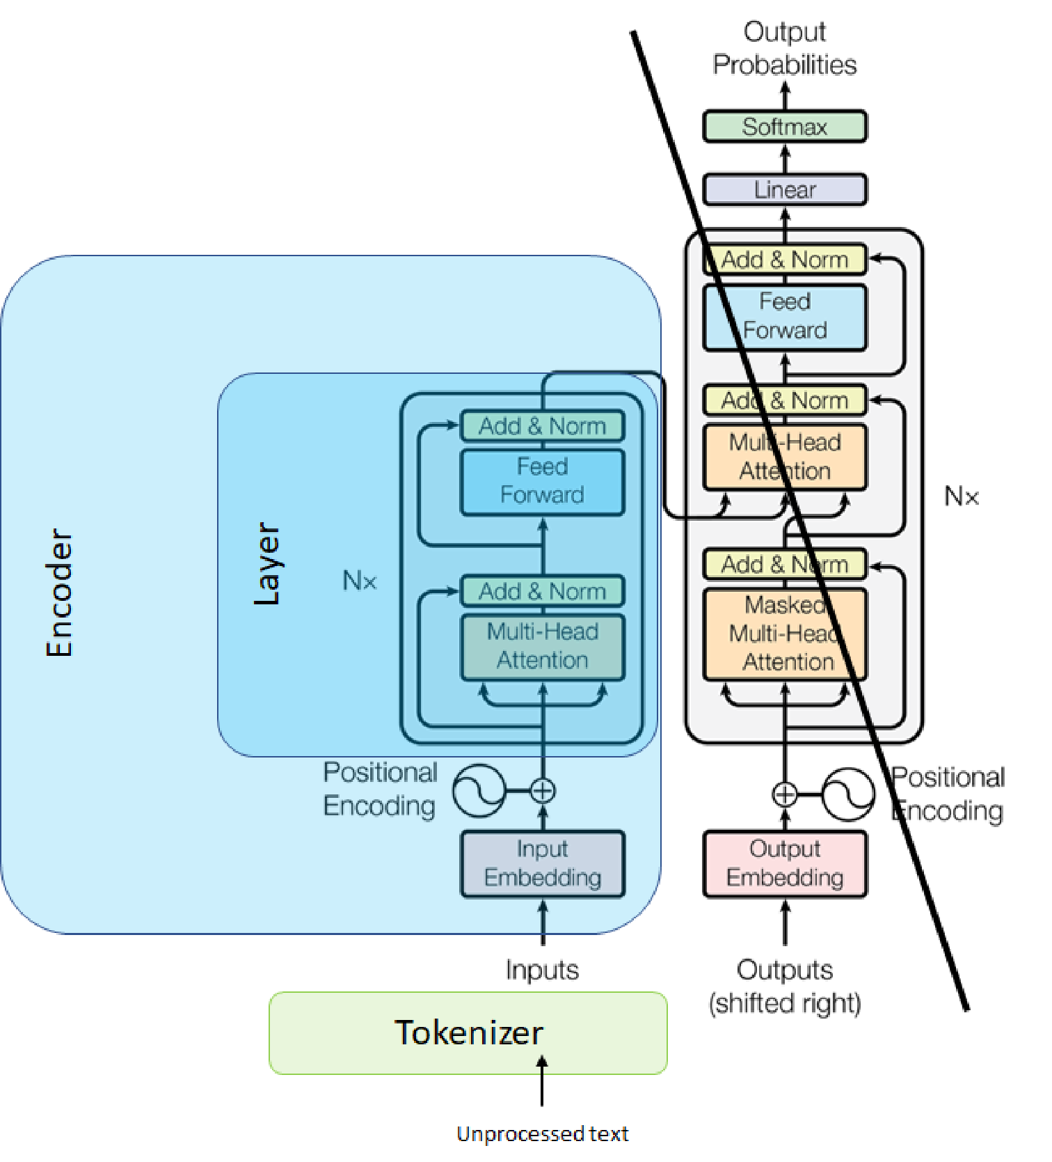
Bert
How it relates to transformer and pretraining

Slide 84
In The Next Class…
Notes:
To put it in perspective

Slide 85
Self-supervision, BERT, and beyond
Why did models start to work well? What does the future hold?
?

Slide 86
Part 1: Machine Learning in NLP
Lecture
What is NLP?
Problem Formulation
Text Representations
Dimensionality Reduction
Embeddings
RNNs
“Attention is All You Need”
Lab
Transformer Architecture
BERT Model
Pretraining BERT
Notes:
Move on to the lab, which will cover these topics.

